Slide 1
Adaptive Learning through Digital Technology
CIET - Online Training on Digital Technology for Children with Special Needs
Day 5: 13th October 2023
By Shankar Subbiah S Assistive Technology and Accessibility Consultant / Director, Agate Infotek, Chennai

Slide 2
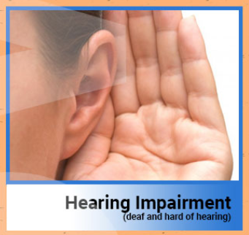
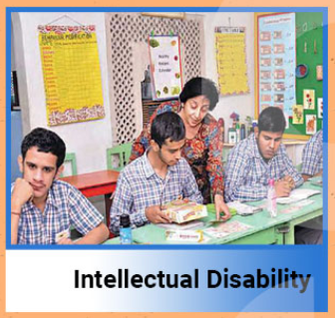
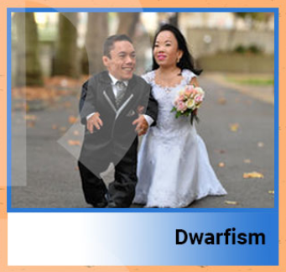
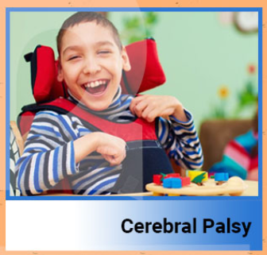
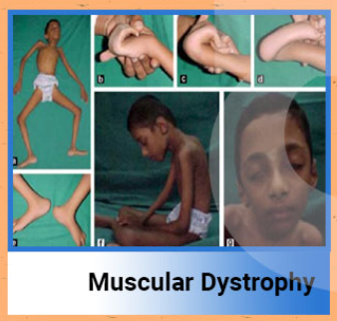
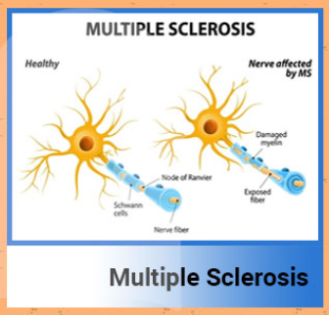
Types of Disabilities as per Rights of Persons with Disabilities Act 2016 – Country Context

Slide 3
Understanding Functional Difficulties for Adaptations needs in Learning
Seeing (things close-up or far away, like objects, faces or pictures due to Total Blindness, Low Vision, Cortical Visual Impairment, Visual Processing)
Hearing (sounds like peoples’ voices or audio due to Hard of Hearing, Deafness)
Gross Motor activities (standing, walking, positioning, sitting, climbing, lifting, extending, swinging)
Fine Motor activities (using hands and fingers, such as picking up small objects like button or holding pencil, rotating compass, drawing or opening and closing containers)

Slide 4
Understanding Functional Difficulties for Adaptations needs in Learning (Contd.)
Speaking (oral speech, not clear for understanding, stammering, conversing in own or other language)
General Learning related (remembering, organising, understanding, comprehending, reasoning)
Specific Learning related (reading, writing, motor coordination, calculations, specific language grammar)
Behaviour / Attention / Socialisation related (focusing, concentration, behaviour adjustments, accepting changes, group work)
Emotions (sad or worried, depressed, anxious)
Health Conditions (treatment, medications, fatigue)

Slide 5
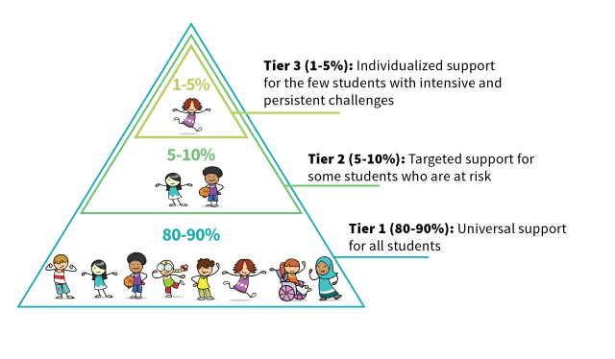
Educational Environment for Adaptive Learning
Inclusive Schools
Open Schooling
Special Schools
Multi-Tiered Support System for Academic and Behavioral supports
Notes:
https://studentbehaviorblog.org/multi-tiered-systems-of-support-pyramid/
https://studentbehaviorblog.org/tag/multi-tiered-systems-of-support-mtss/

Slide 6
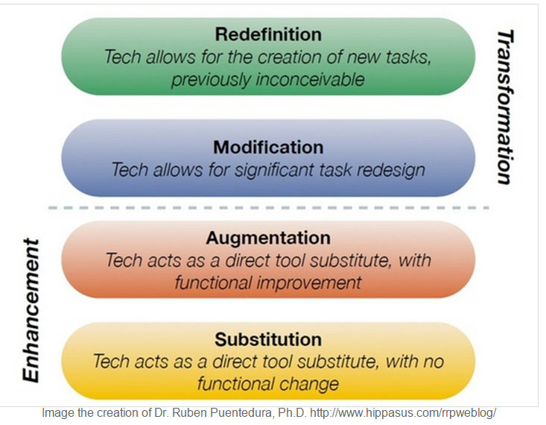
Why Digital Technology in Teaching and Learning Environment?
Teaching
SAMR Model
Learning
Notes:
“SAMR” is an acronym that stands for Substitution, Augmentation, Modification, and Redefinition. The SAMR model was designed and developed by Dr. Ruben Puentedura of MIT provides a technique for moving through degrees of technology adoption to find more meaningful uses of technology in teaching and move away from simply using “tech for tech’s sake”.

Slide 7
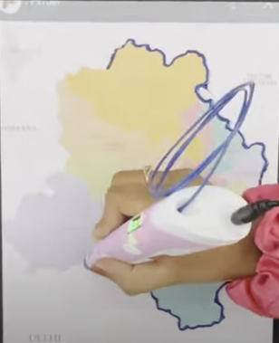
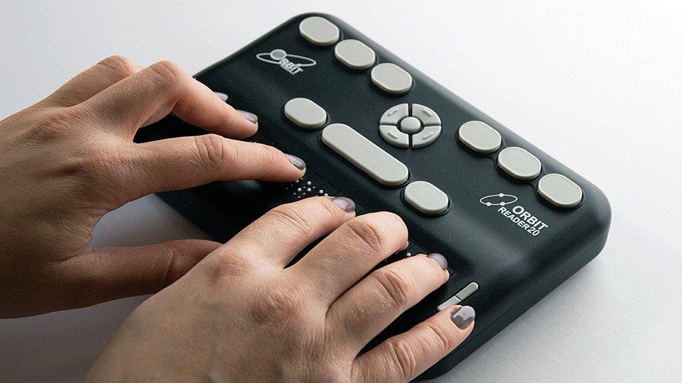
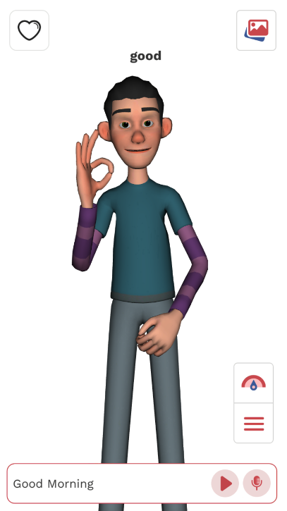
What content delivery options are available for Adaptive Learning?
Formatted / Enlarged Text / Digital Braille
Visual Graphics / 3D Printed Models / Tactile (Touch and Feel) Graphics))
Audio / ePUB
Books with Highlighted, Read aloud, Magnified, Line Reading
Presentations / Videos with Captions / Sign Language Interpretations
Notes:
https://raisedlines.org/
https://play.google.com/store/apps/details?id=com.Indic.DefAnimation&pli=1

Slide 8
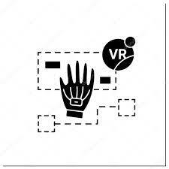
What content delivery options are available for Adaptive Learning?
Interactive Meetings
Simulations
Immersive Content (Virtual, Augmented, Mixed and Extended Reality
eLearning Platforms
Web / Mobile Apps
Notes:
https://www.olabs.edu.in/
https://www.vlab.co.in/
https://www.olabs.edu.in/?pg=topMenu&id=288
https://www.youtube.com/watch?app=desktop&v=dTv2cY8grtQ
Shyam Vengallur, Social Science Teacher - AEMAUP School in Malappuram's Moorkkanad using augmented reality for its virtual classes

Slide 9
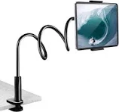
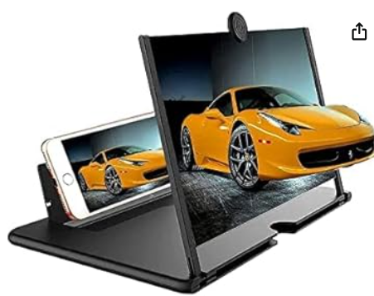
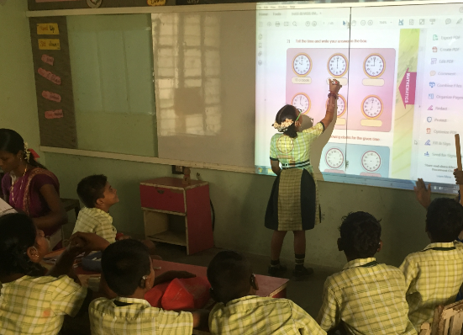
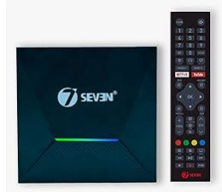
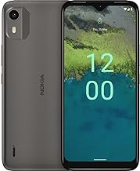
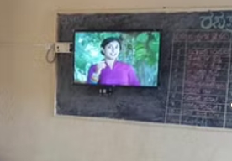
What presentations modes can be planned in the process of Adaptive Learning?
Presentations with support of Applied Digital Technology
Class Board Nearer to Children Participating
+
+
Inclusive
Participatory
Classrooms
Smart Phone
TV with HDMI Port
Android Box
Notes:
https://www.youtube.com/watch?v=8Q8YcXrg4rM
https://www.amazon.in/7SEVENTM-X96Q-Max-Quad-Core-Bluetooth/dp/B09H87MRCZ/ref=sr_1_7?keywords=Android+Smart+TV+Box&qid=1697081649&sr=8-7

Slide 10
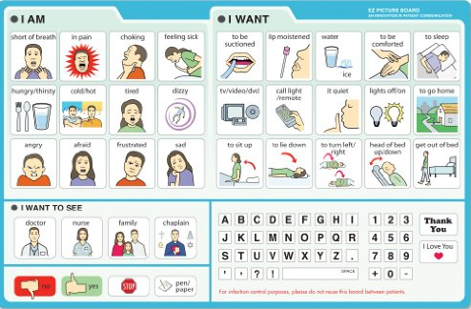
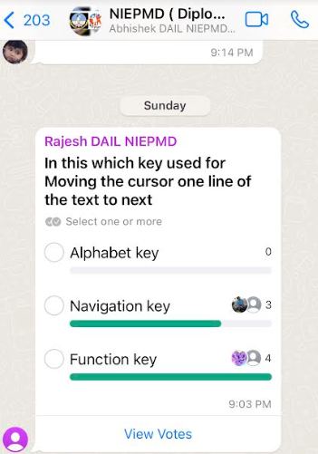
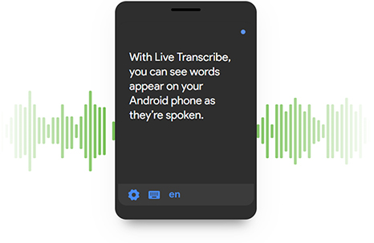
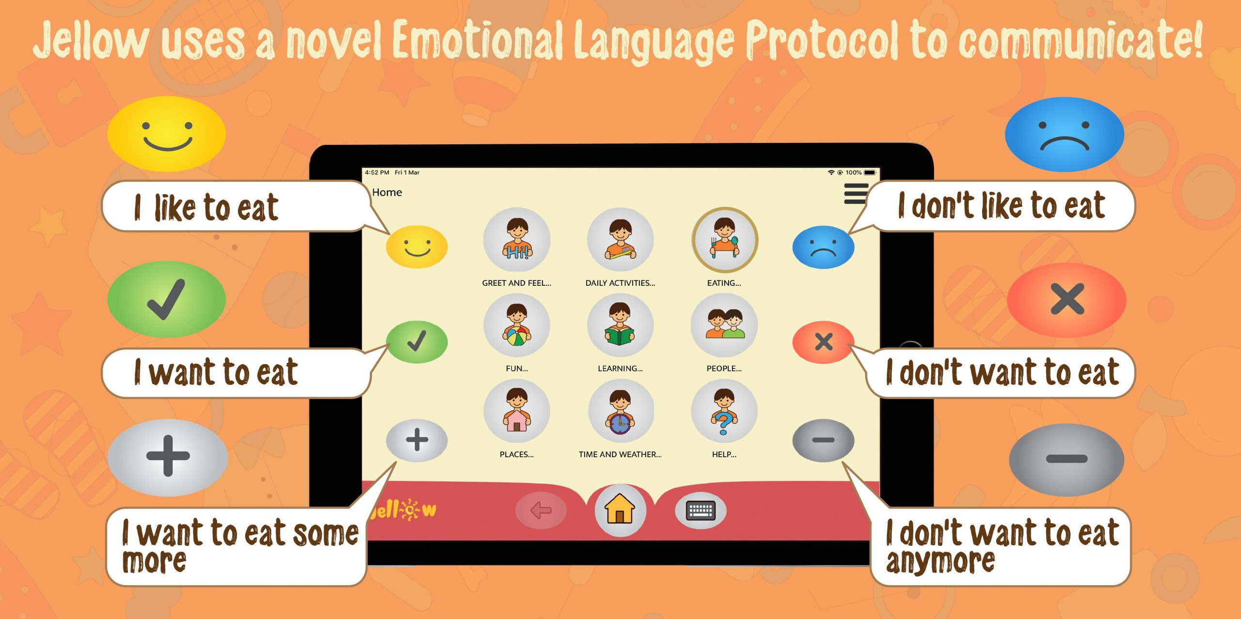
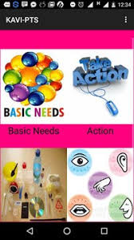
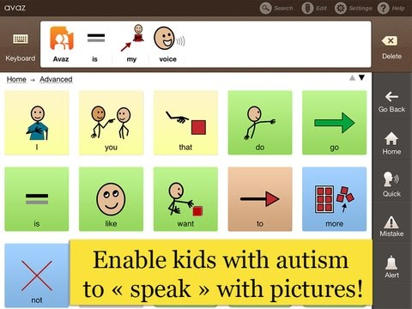
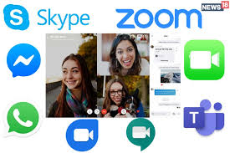
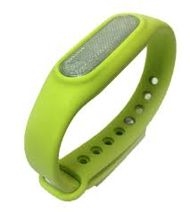
How to communicate, express, participate for Adaptive Learning in Classrooms?
Live Transcribe
Indic AI
Communication Charts
Jellow Plus, KAVI PTS, AVAZ, - AAC Apps and iGest Device
Accessible Social Media, Video Call and Meeting Apps

Slide 11
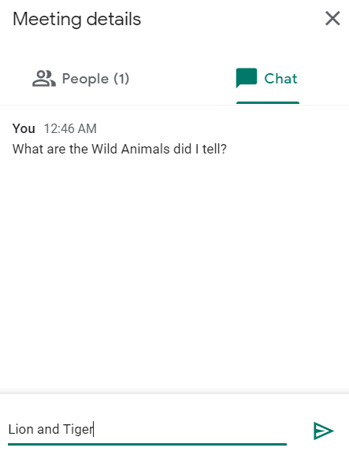
How to do Interactive Activities for Adaptive Learning Online?
Jamboard (jamboard.google.com) / Jamboard App in Google Play Store

Slide 12
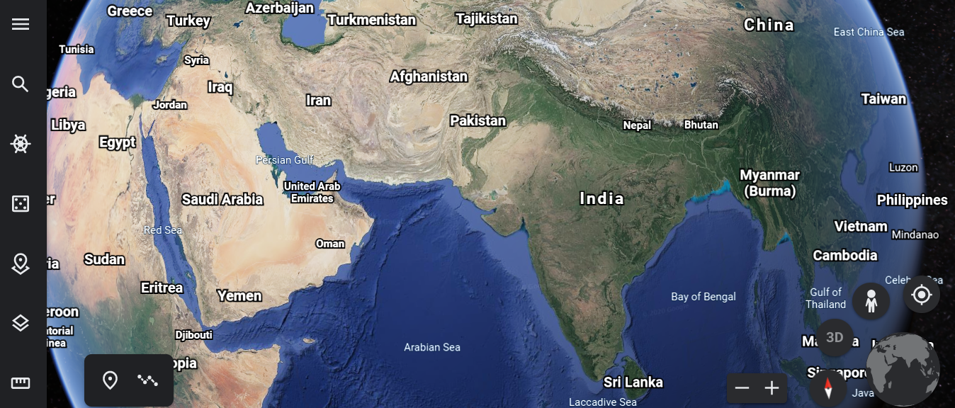
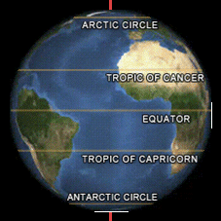
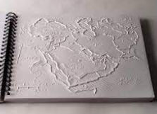
Presentations for Adaptive Learning
Learning Our Earth 🌎 as an Example
Equator
Globe
Google Earth
Tropic
Tactile Graphic Map
Draw 3D Earth Map
Sign Language
Notes:
https://earth.google.com/web/
Sign Language
https://www.youtube.com/watch?v=mJWo1-VetAE
Draw 3D Earth
https://www.youtube.com/watch?v=Scb0_uoVmts

Slide 13
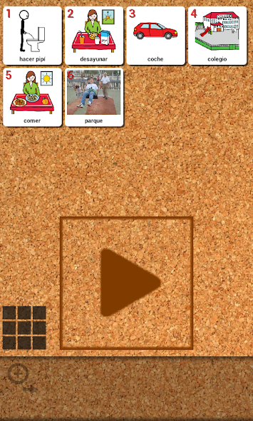
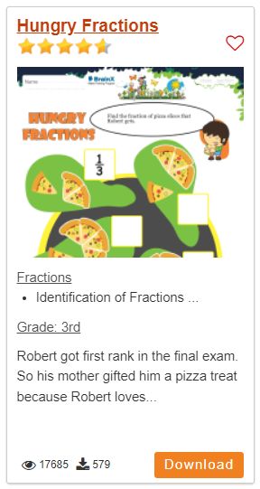
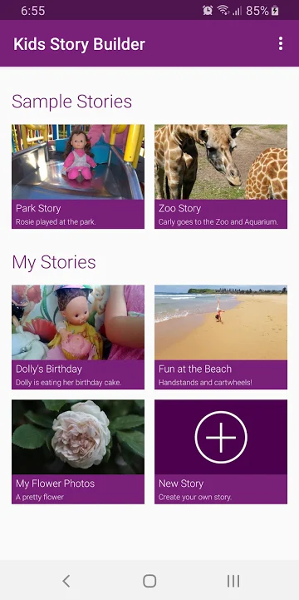
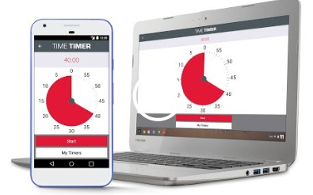
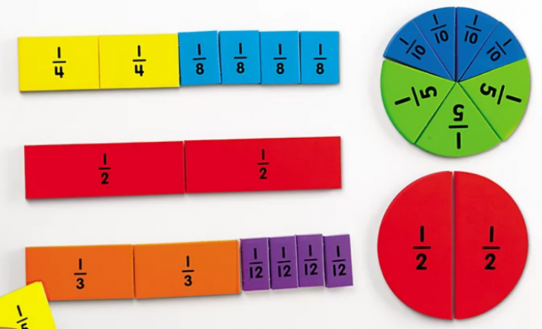
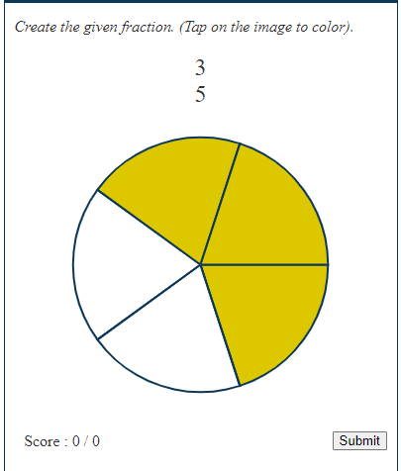
Presentations for Adaptive Learning (Contd.)
Learning Fractions as an Example
Visual Timers (Time Timer)
Pictogram Agenda
(Steps and Procedures)
Kids Story Builder
3D Models / Tabletops out of Cardboards / Foam (Touch, Feel, Join, Separate and Learn
Worksheets (Do and Learn)
Online Games
Notes:
https://logicroots.com/math-worksheets/
https://pschool.in/math/fraction
https://edqueries.com/courses/fractions/

Slide 14
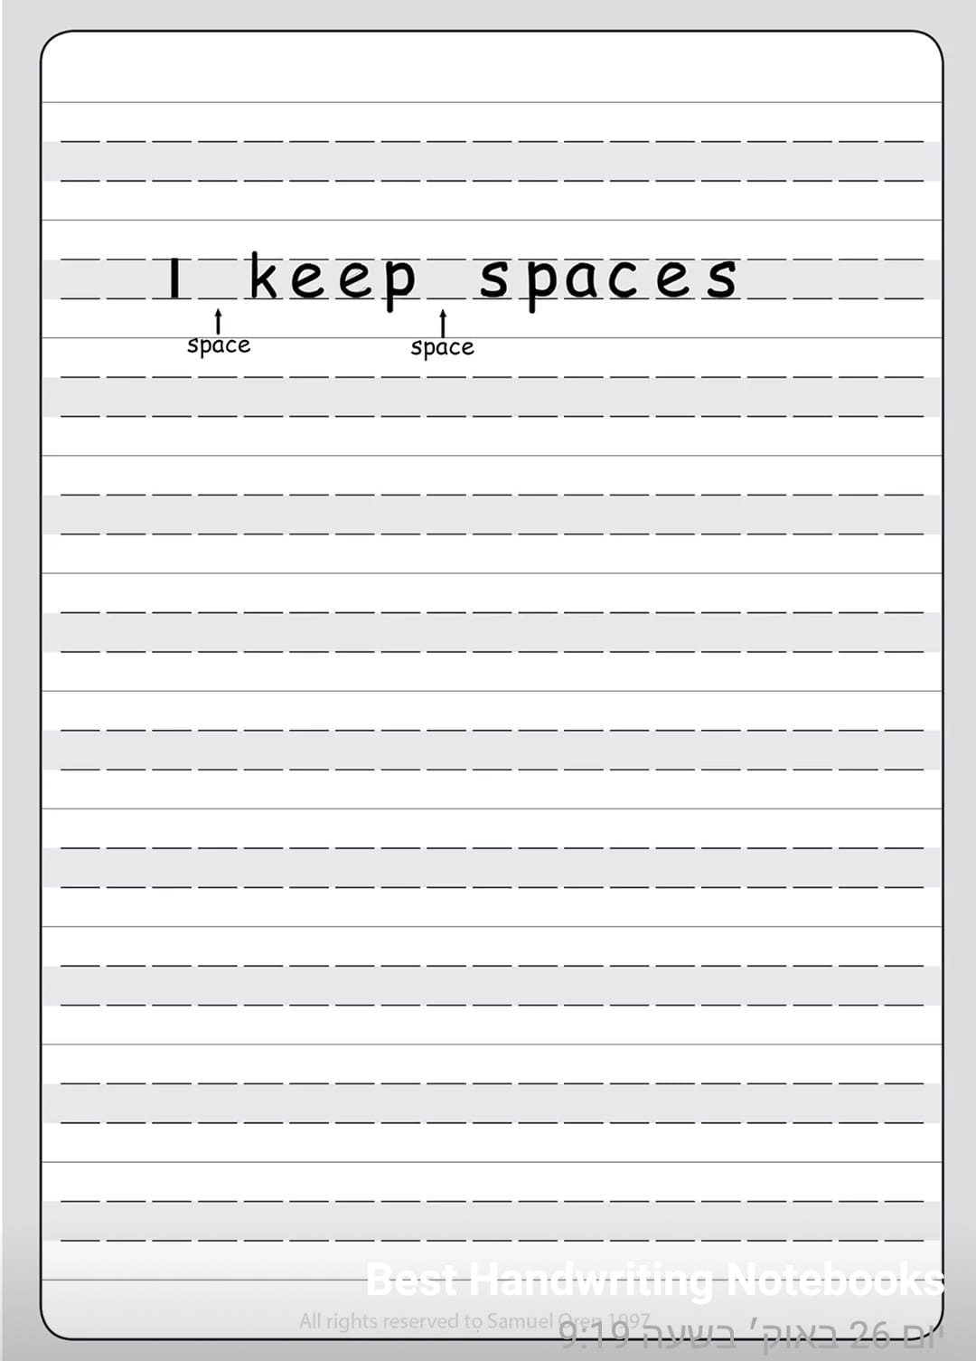
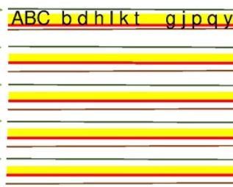
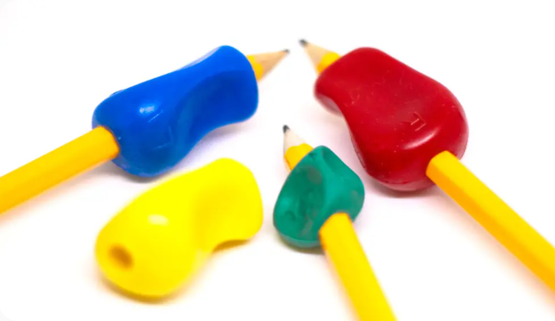
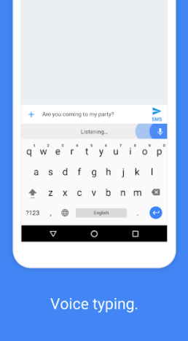
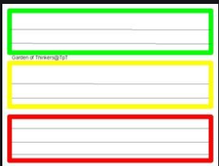
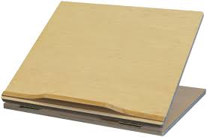
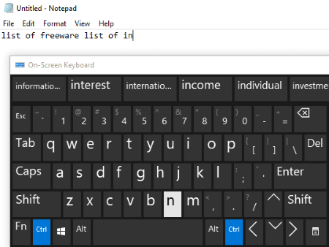
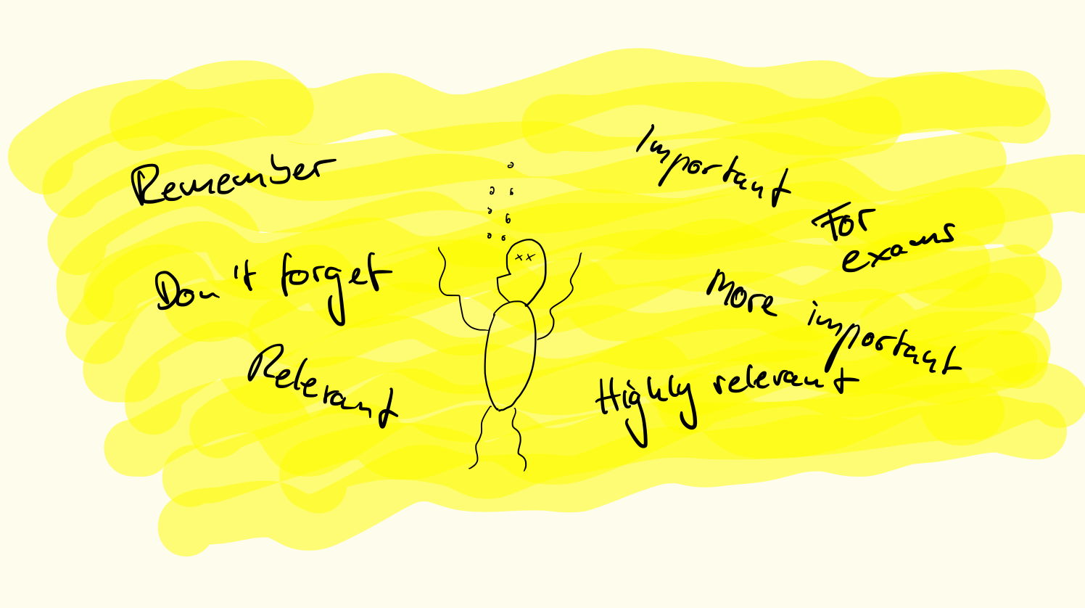
How to do Activities and Express in the process of Adaptive Learning in Classrooms?
Writing / Drawing can be made easier / Joyful
GBoard
Google
Voice / Draw
Typing
Hand Grips
Raised Line Paper
Writing Guides
Slant Boards
On Screen Keyboard with Word Prediction
Notes:
https://logicroots.com/math-worksheets/
https://pschool.in/math/fraction
https://edqueries.com/courses/fractions/

Slide 15
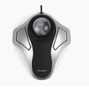
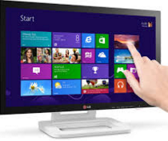
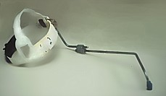
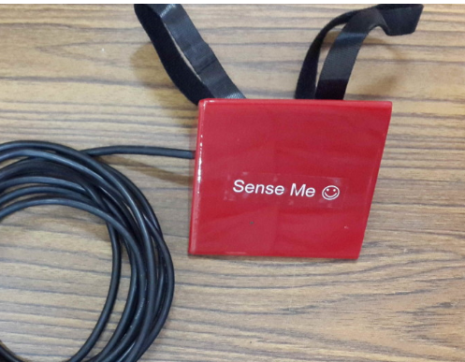
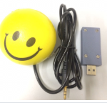
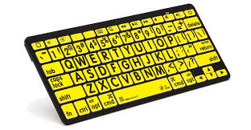
Assistive Technology for access to Computers and Mobile devices for Children with Difficulties in Movements, Positioning
Broad Hit Mouse
Trackball
Touch Screen
Head Gear Pointer
Mouth Pointer
Gesture Mouse
Smiley Ball
Mini Keyboard
Bright Keyboard
Foot Mouse
Head Movement Mouse
Mobile
Face
Pointer
Hard Hit Keyboard
On Screen Keyboard
GBoard
Notes:
Touch Screen, Head or Mouth pointers, Bluetooth mouse, Click, Roll Trackball, Clevy Keyboard, Mini Keyboard, Colour Coded Keyboard, Foot Pedal Mouse, Mouseware, Ease Apps, Eva Mouse, Onscreen Keyboard

Slide 16
Assistive Technology for access to Computers and Mobile devices for Children with Difficulties in Movements, Positioning
Notes:
Touch Screen, Head or Mouth pointers, Bluetooth mouse, Click, Roll Trackball, Clevy Keyboard, Mini Keyboard, Colour Coded Keyboard, Foot Pedal Mouse, Mouseware, Ease Apps, Eva Mouse, Onscreen Keyboard

Slide 17
Born Accessible e-Content Guidelines by NCERT and DoE, GoI
Notes:
https://dsel.education.gov.in/sites/default/files/2021-06/CWSN_E-Content_guidelines.pdf
NCERT – National Council for Education Research and Training, DoE – Department of Education, GoI – Government of India

Slide 18
What to do in Content for Adaptive Learning through Technology implementation?
Fonts for use (Print / Presentations)
Arial abcdefghijklmnopqrstuvwxyz
Calibri abcdefghijklmnopqrstuvwxyz
Verdana abcdefghijklmnopqrstuvwxyz
Comic Sans MS abcdefghijklmnopqrstuvwxyz
Open Dyslexic abcdefghijklmnopqrstuvwxyz
Times New Roman
Fonts Size - Min. 12 points for Print materials
Fonts Size - Min 20 / 24 / 28 points for Presentations
Line Space – Min 4 points higher than Fonts size
Text - Avoid Underlining, italics, BLOCK CAPITALS (for Headings, Content)
Use Bold for emphasis.
Use Red, Blue, Orange, Yellow, Green, colours appropriately.

Slide 19
What to do in Content for Adaptive Learning through Technology implementation
Alternative Text for Images /
Captions
Text / Background Contrast Colours (Min 70%)
YouTube Studio – Transcripts / CC Enable

Slide 20
What to do next for Adaptive Learning through Technology implementation?
Explore new digital techniques as a chance for you to learn, not just your students
Challenge yourselves to learn and try new Digital tools and software
Become more Technically Savvy
YouTube Chat GPT Bard Bing
Step back and Observe if they know better
Not only teach Digital Skills! Engage!!!
Not only Students, Exchange with Other Stakeholders!!!
Share the work in DIKSHA and other Platforms
Notes:
https://bard.google.com/
https://chat.openai.com/auth/login
https://openai.com/research/dall-e

Slide 21
Technology is an Enabler and a Game Changer for Children with Special Needs
Thank You All For The Opportunity !
S. SHANKAR SUBBIAH
ASSISTIVE TECHNOLOGY & ACCESSIBILITY CONSULTANT / Director, Agate Infotek, CHENNAI
9840097237 | shankar@agateinfotek.in shankar.ata@outlook.com Twitter: @shankaraa

